Slide 1

Operation Analytics and Investigating Metric Spike
Project By: Sneha Pasalkar
Platform: SQL workbench

Slide 2

Business task
Analyze end to end operations of the organization to identify areas of improvement, identify investigating metric spikes, so that we can answer questions posted by different departments of organization to help them improve operations and understand sudden changes in key metrics

Slide 3
Description of project
Operational Analytics is a crucial process that involves analyzing a company's end-to-end operations.
Will take on the role of a Lead Data Analyst at a company.
Work closely with various teams, such as operations, support, and marketing, helping them derive valuable insights from the data they collect.
Task will be to derive insights from this data to answer questions posed by different departments within the company that can help improve the company's operations and understand sudden changes in key metrics.

Slide 4
Approach
Our approach to this project will be mainly divided into two main parts:
Case Study 1: Job Data Analysis
Contains only one table job_data for analysis
Case Study 2: Investigating Metric Spike
Contains 3 tables: users,events,email_events

Slide 5
Case Study 1 -Job Data Analysis
Jobs Reviewed Over Time
Throughput Analysis
Language Share Analysis
Duplicate Rows Detection

Slide 6
Case study 2 - Investigating Metric Spike
Weekly User Engagement
User Growth Analysis
Weekly Retention Analysis
Weekly Engagement Per Device
Email Engagement Analysis

Slide 7
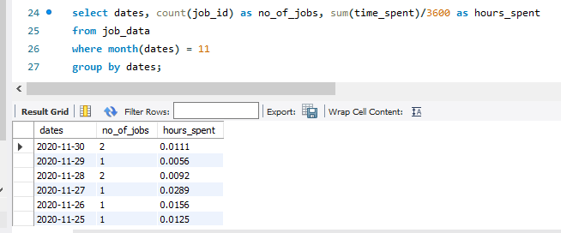
Job Data Analysis
Jobs Reviewed Over Time
Task 1: calculate the number of jobs reviewed per hour for each day in November 2020

Slide 8
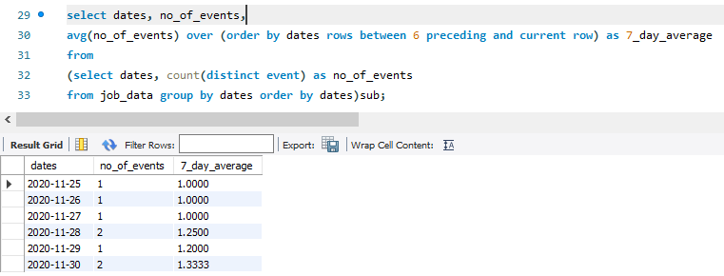
Throughput Analysis
Task: Write an SQL query to calculate the 7-day rolling average of throughput. Additionally, explain whether you prefer using the daily metric or the 7-day rolling average for throughput, and why
Throughput is basically average of events, if we choose daily, data will be as huge as table and eventually it will be difficult to find patterns, hence we should use weekly or monthly or quarterly throughput, I have used weekly for same reason

Slide 9
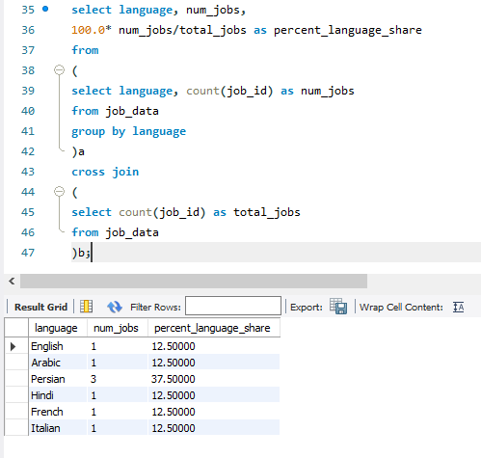
Language Share Analysis:
Task: Write an SQL query to calculate the percentage share of each language over the last 30 days

Slide 10
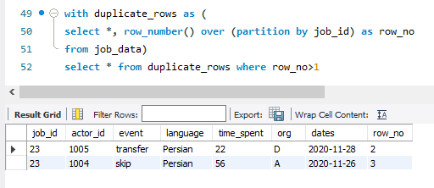
Duplicate Rows Detection
Task: Write an SQL query to display duplicate rows from the job_data table

Slide 11
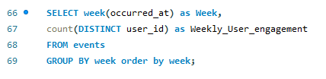
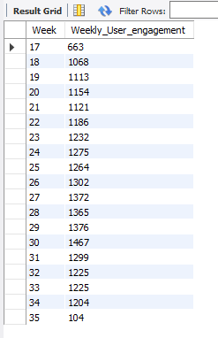
Case Study 2: Investigating Metric Spike
Weekly User Engagement:
Task: Write an SQL query to calculate the weekly user engagement

Slide 12
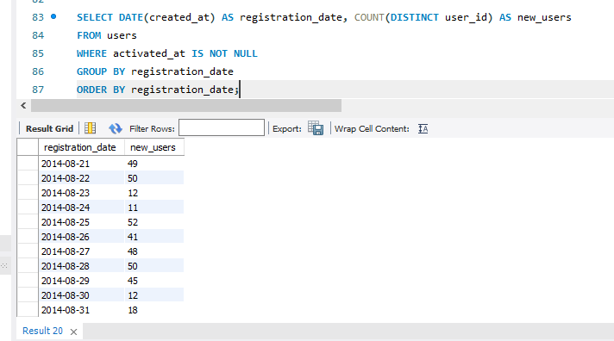
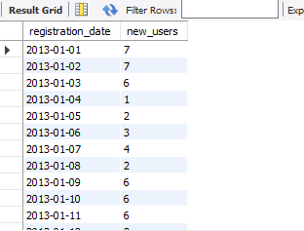
User Growth Analysis:
Task: Write an SQL query to calculate the user growth for the product

Slide 13
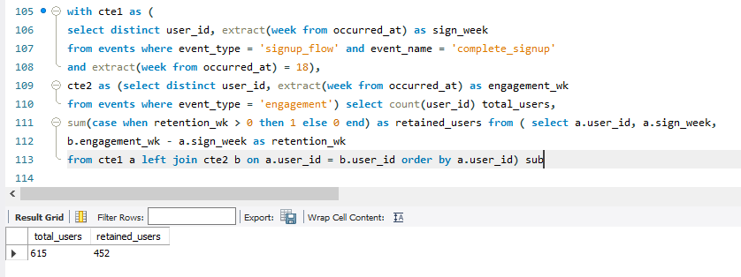
Weekly Retention Analysis:
Task: Write an SQL query to calculate the weekly retention of users based on their sign-up cohort.

Slide 14
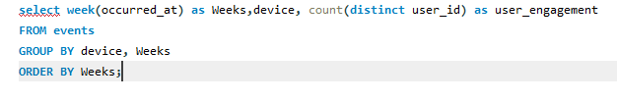
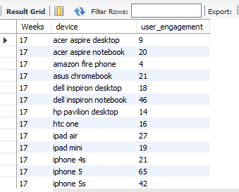
Weekly Engagement Per Device:
Task: Write an SQL query to calculate the weekly engagement per device

Slide 15
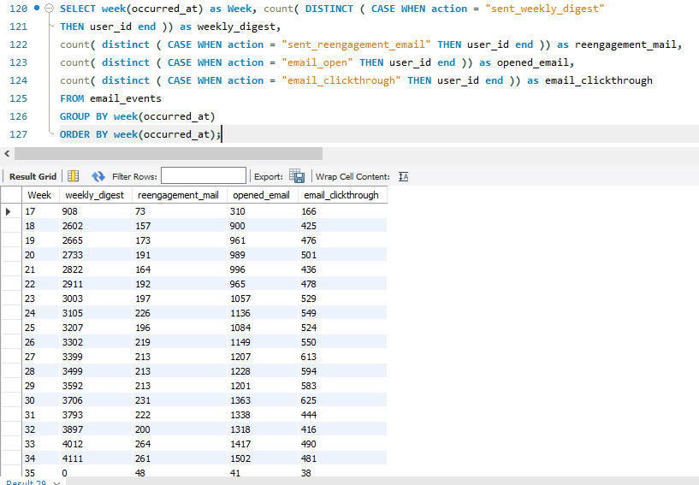
Email Engagement Analysis
Task: Write an SQL query to calculate the email engagement metrics

Slide 16
Insights:
On an average 0.01 jobs are reviewed per day per hour
7 day rolling average is between 1 to 1.33
Persian language holds highest percent share of 37.50%
Our job_data table shows 2 duplicate records with same job id 23
Weekly engagement analysis shows we have trends in user engagement as increasing and decreasing on 2 weeks period but it decreased drastically in week 35, we should perform RCA to overcome this
Growth analysis shows number of new users per day, which reflects we have less number of new users in the beginning and we can see considerable increase in later part which is good sign
Retention analysis shows 452 retained users which needs to be focused in order to perform well
Weekly engagement analysis shows we are doing well with different devices, that means our compatibility is good in terms of being accessible through different devices
Email engagement analysis shows details regarding different email activity aspects per week, this also shows on an average only 50% emails are being clicked through compared to opened email per week, we need to perform RCA here too to improve engagement via email

Slide 17
THANK YOU!

